Slide 1


MIE1624: Introduction to Data Science and Analytics Assignment1: Kaggle ML & DS Survey Challenge
Submitted to: Prof. Oleksandr Romanko
Submitted by: Krishna Pattabi Haridoss, 1006583591
Date: 12 Oct 2020

Slide 2
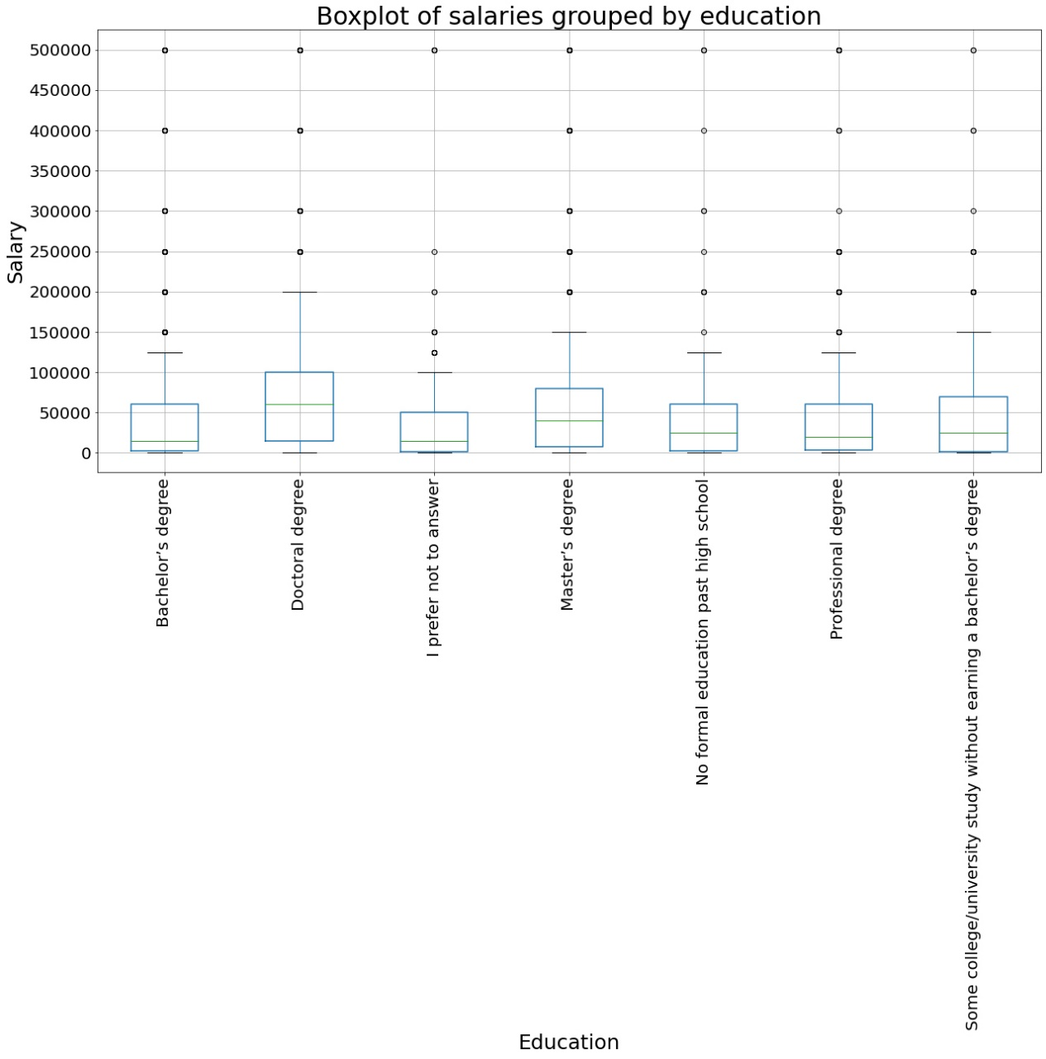
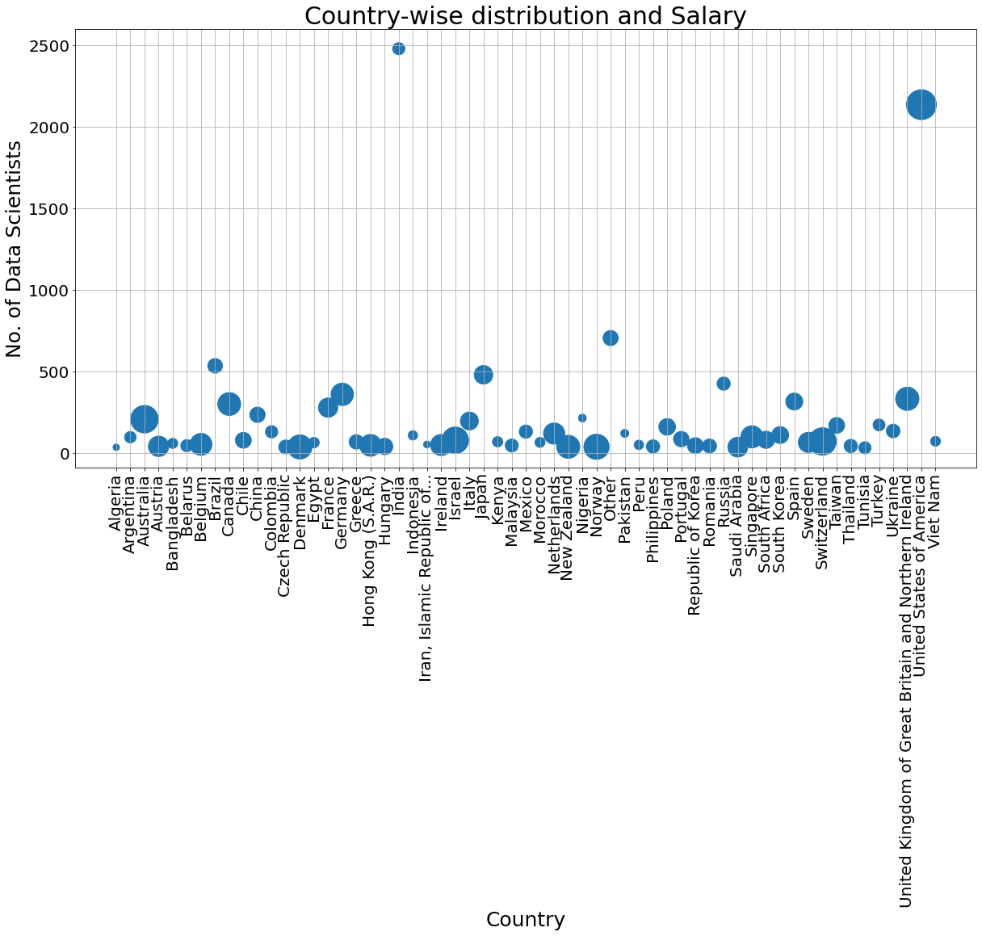
Exploratory analysis:
Exploratory data analysis reveals that data scientists receive higher salaries when their education level is higher
It is also evident that there is a significant change in salaries between different countries
No. of data scientists in a country has no significant impact on the salary of data scientists in that country

Slide 3
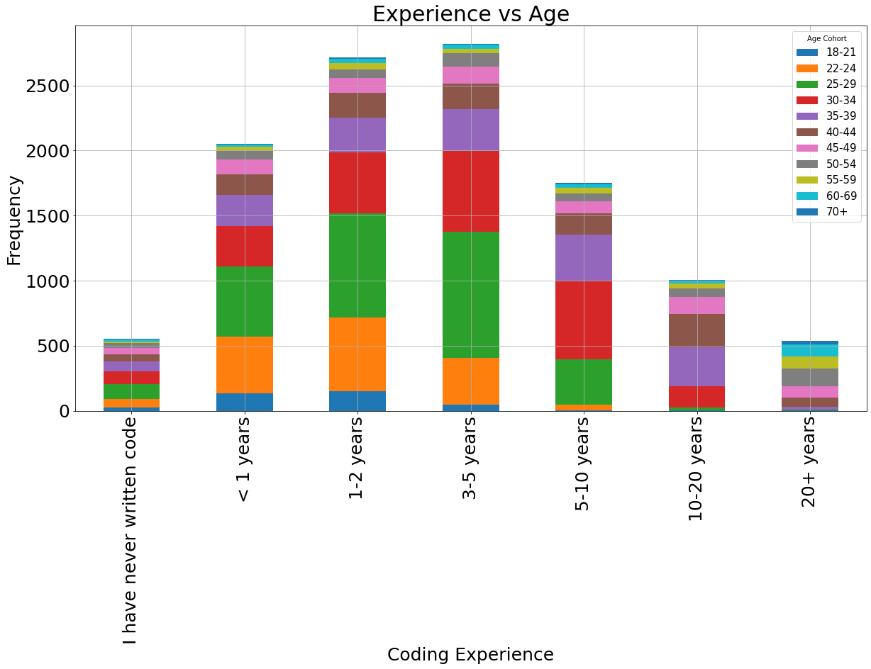
Relatively newer field since most of the age distribution is within 10 years
Experience is tied closely to the age, evident in 35-44 bracket in 10-20 years experience cohort.

Slide 4
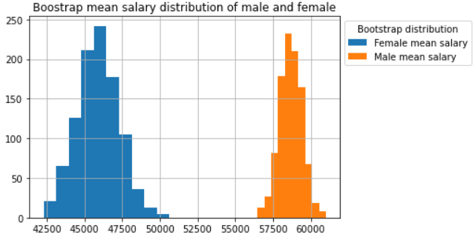
Salary difference between male and female: T-test to find the statistical significance of salary difference between male and female data scientists
Original data | Gender |  | T-test values
 | Male | Female | t-value | P-value
Sample count | 10473 | 1827 | -6.909 | 5.108e-12
Mean salary | 58709.59 | 45933.77
Bootstrapped data with replacement
Bootstrapped samples | 10473 | 1827 | -253.858 | 0.0
Iterations | 1000 | 1000
Mean salary | 58716.48 | 45964.48
T-test here reveals that there is a statistically significant difference in salaries between men and women.

Slide 5
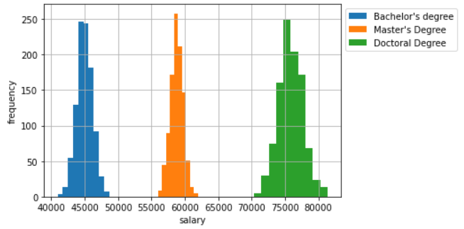
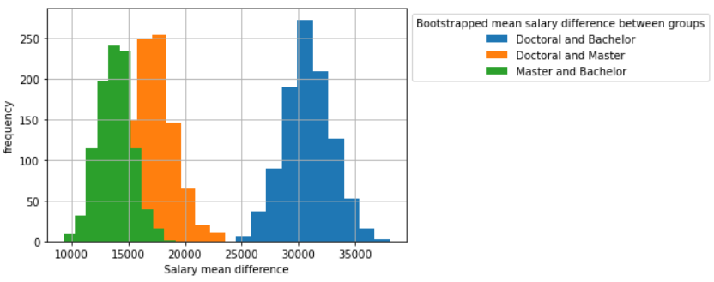
Salary difference with education: ANOVA-test to find the statistical significance of salary difference between data scientists with Bachelor’s, Master’s and Doctoral degrees
Original data | Gender |  |  | T-test values
 | Bachelor’s | Master’s | Doctoral | Statistic | P-value
Sample count | 3361 | 5868 | 2083 | 117.83 | 2.23e-51
Mean salary | 44999.256 | 58778.629 | 75761.40
Bootstrapped data with replacement
Bootstrapped samples | 3361 | 5868 | 2083 | 130928.048 | 0.0
Iterations | 1000 | 1000 | 1000
Mean salary | 45007.98 | 58773.799 | 75733.95
ANOVA test reveals that there is a statistically significant difference in salaries between Bachelor, Master and Doctoral degree holders.

